Slide 1
HydroponicsMachine
Github repo:
https://github.com/jannepetter/hydroponicsMachine
Sakari Väisänen, Petri Hinttala and Janne Uutela

Slide 2
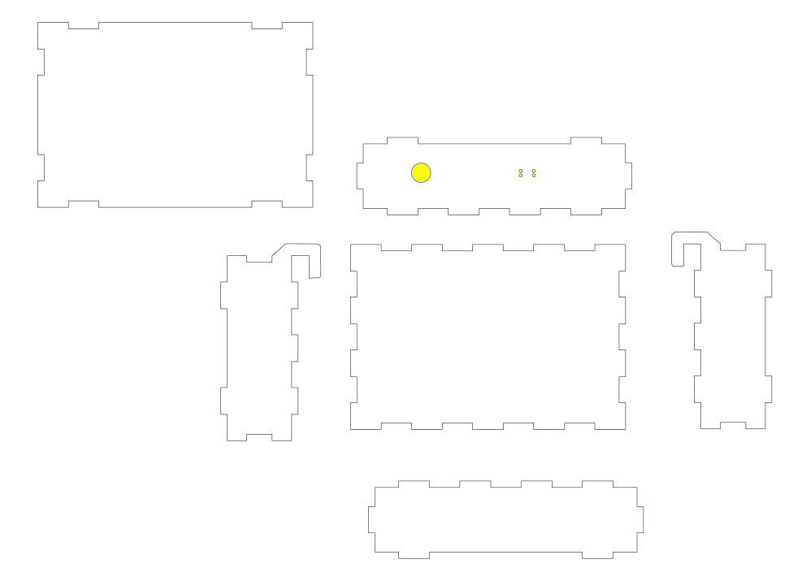
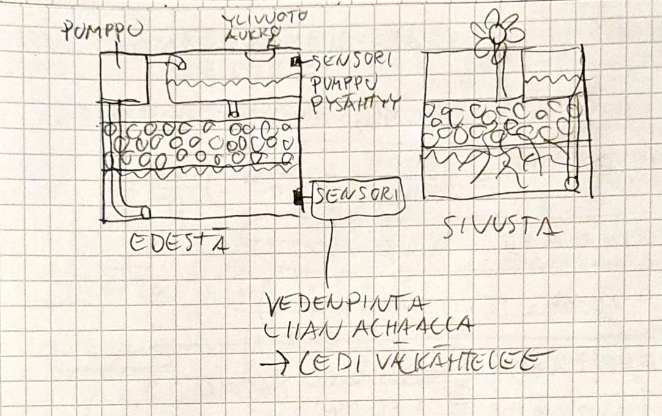
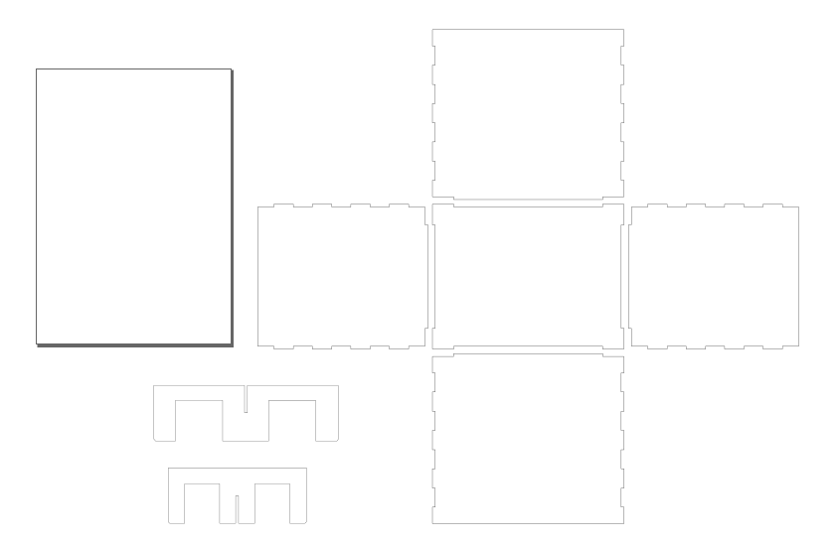
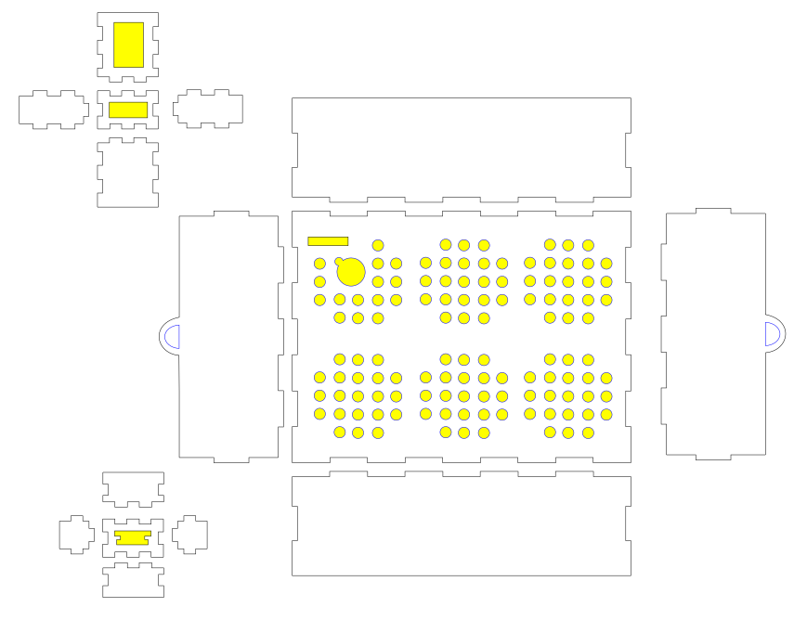
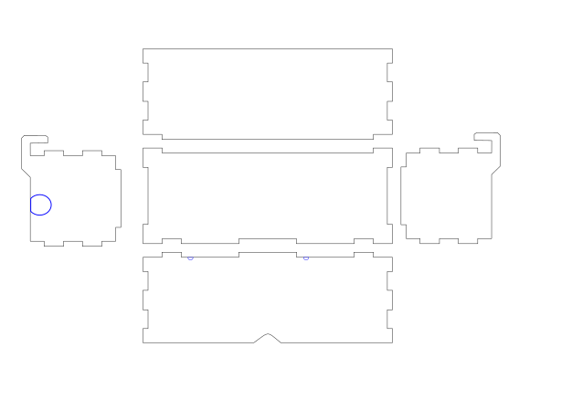
Sketching
- arduinobox
- maintank
- Gravelbox and sensor holder
- minitank

Slide 3
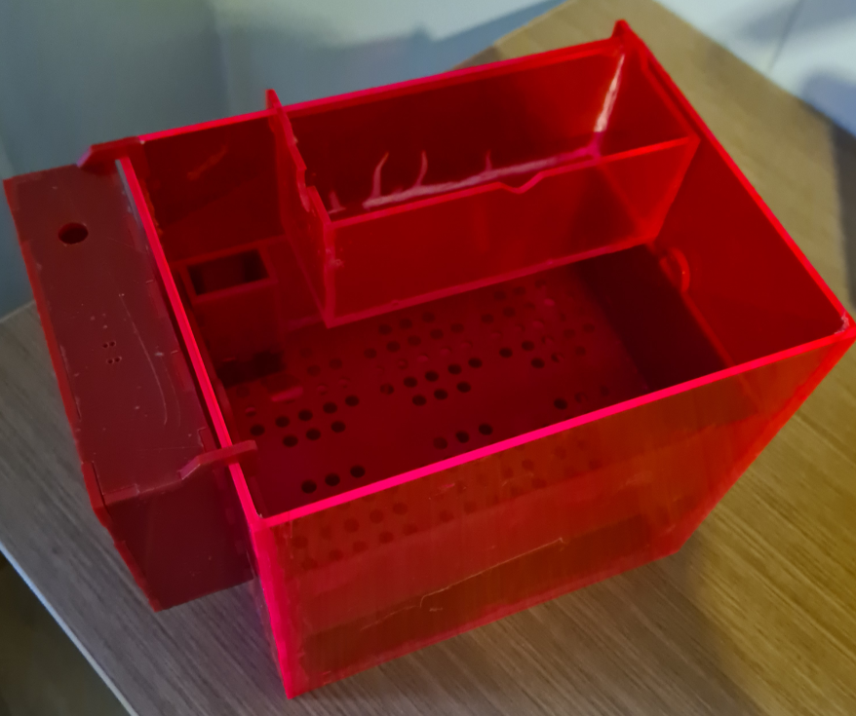
Outer parts assembled
Holds water!
We had minor cracks while gluing the maintank together. (Kerf 0,18 and joint clearance 0,001). We used kerf 0,18 and clearance 0,005 for the rest of the parts.

Slide 4
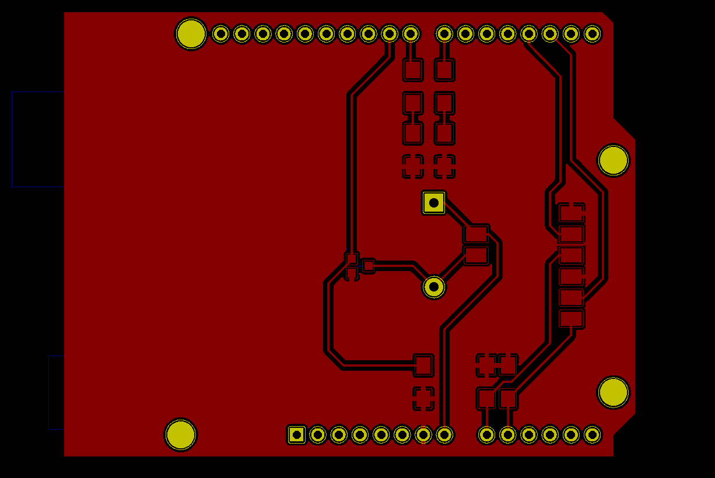
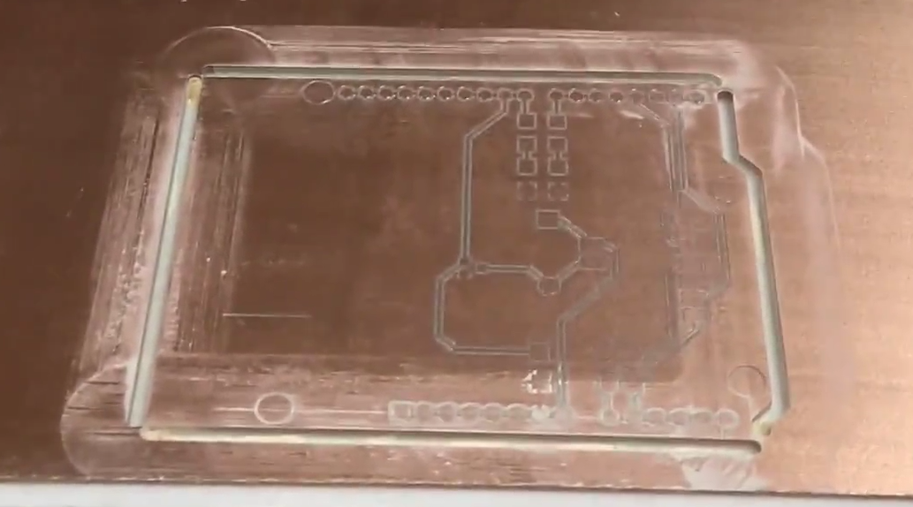
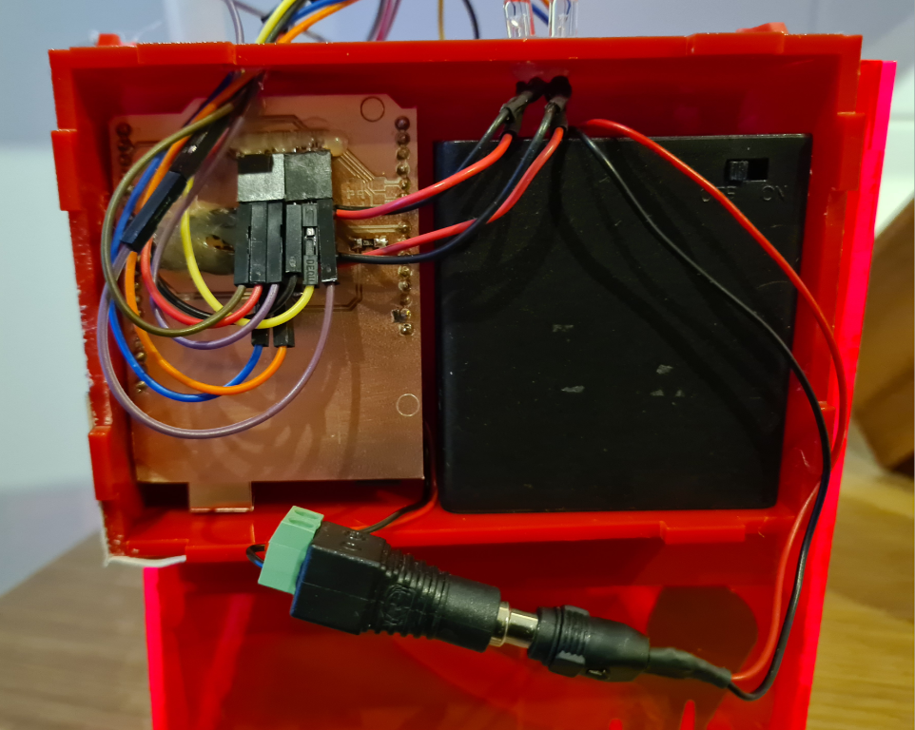
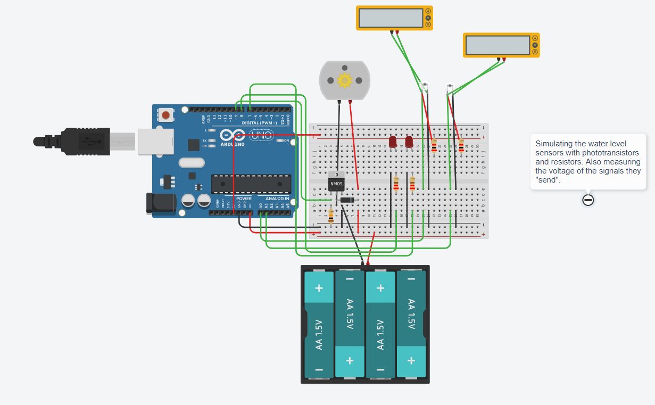
Circuit card

Slide 5
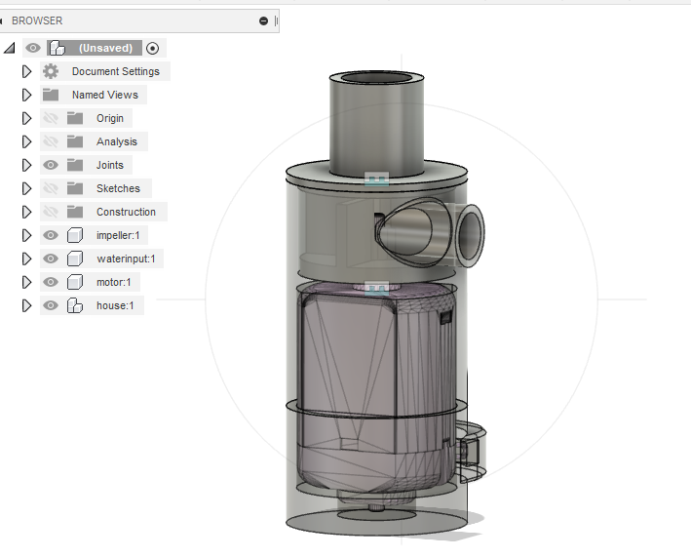
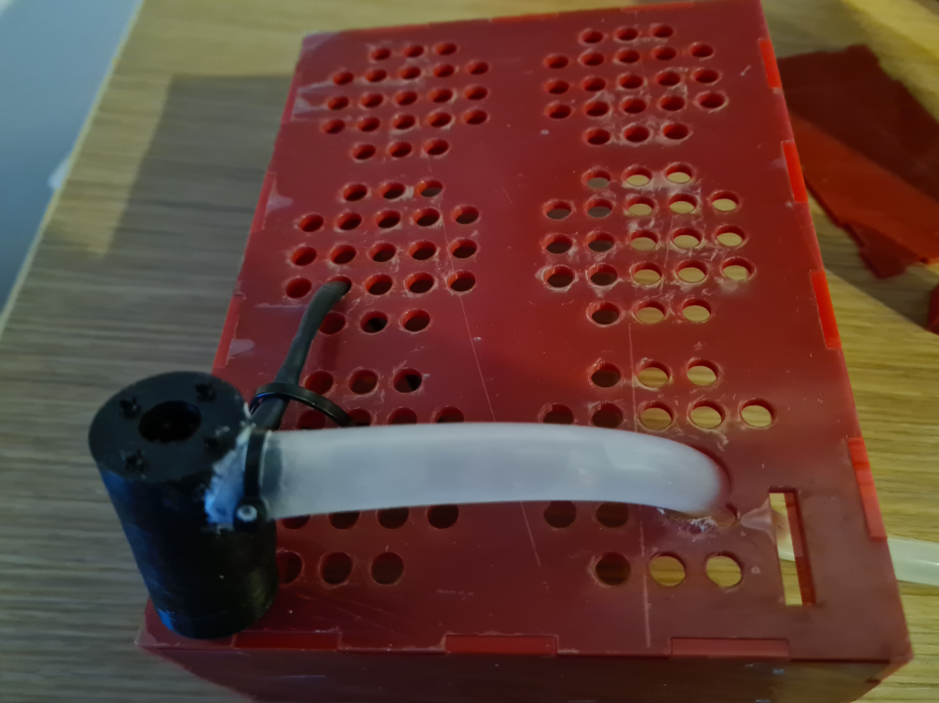
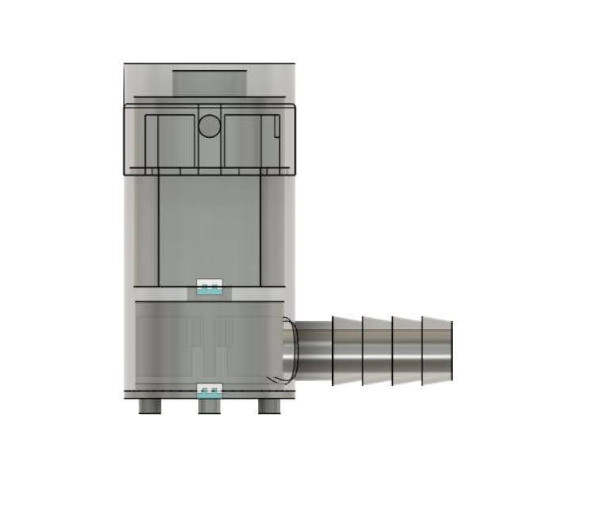
Version 1
Water pump
Version 2

